Slide 1
Lesson 9: Proportional Control Action
ET 438a Automatic Control Systems Technology

Slide 2
Learning Objectives
After this presentation you will be able to:
Identify the components of a proportional feedback control system.
Write a mathematical model for a proportional controller.
Compute the proportional bandwidth of a proportional controller.
Explain the relationship between steady-state error and proportional gain.
Perform lab experiment 2 more effectively.

Slide 3
Proportional Control Action
Simplest form of controller - amplify error and apply signal to the process through final control element.
Basic control loop
Manipulated
variable
Controlled
variable
Setpoint
value
Controlled
variable
Error
Controller
Final Control
Element
Process
(Plant)
+
-
Signal
Conditioning
Sensor(s)

Slide 4
Proportional Control Action
Example: Dc Motor Speed Control
Dc Supply Control Voltage
Motor Armature Voltage
Desired
Speed
Shaft
Speed
Error
Controller
Variable
Dc Supply
Dc
Motor
+
-
Signal
Conditioning
Speed
Transducer

Slide 5
Proportional Control Math Relationship
Amplify error and send to final control element.
C_{o} = K_{p} e + C_{b}
Where C_{o} = the controller output
C_{b} = the controller output with e =0
K_{p} = the proportional gain
e = the control error
e can be positive or negative. Error used to take corrective action
e = SP - Measurement,
e = error signal
SP = setpoint value
Measurement = sensor measurement

Slide 6
Proportional Control Action
Measurement > SP e negative - output decrease
SP
Error=e
+
C_{o} = K_{p} e + C_{b}
-
negative
Measurement
Measurement < SP e positive - output increase
positive
C_{o} = K_{p} e + C_{b}

Slide 7
Controller Output Limits
Practical controller output devices have limits on C_{o} and final control element. Examples: flow value position, motor power supply
-e
e
Proportional band sets limits of control output.
Determined by value of K_{p}.

Slide 8
Controller Output Limits
At higher K_{p}, e produces more correction but reduces the range between controller limits
V_{o}
K1>K2>K3
+15
K2
K3
K1
V_{error}
Band increases
as gain decreases
-15
Proportional Band

Slide 9
Computing Proportional Band and K_{p}
Proportional gain - change in output /change in error
Increasing proportional gain decreases proportional band (PB). In terms of percent:
%PB inversely proportional to K_{p}

Slide 10
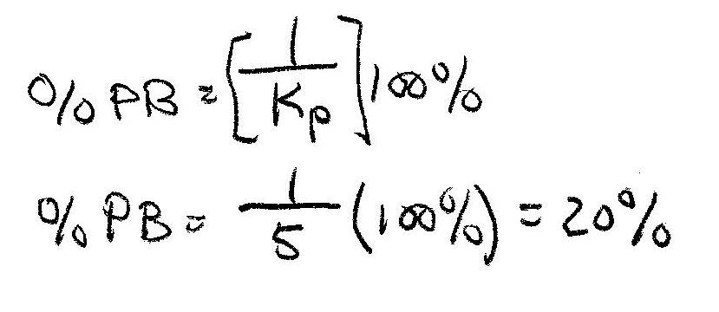
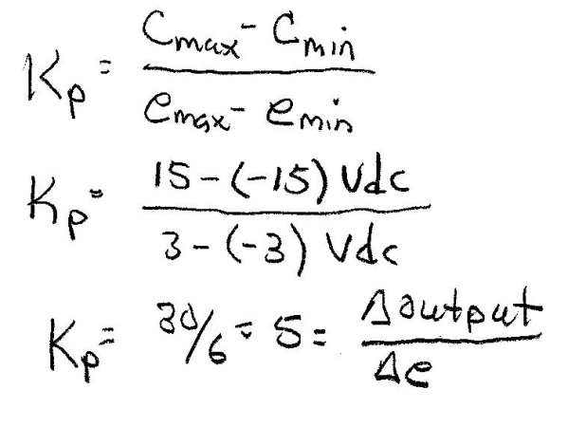
Proportional Control Action
Example 9-1: A proportional controller uses an OP AMP with ±15 Vdc output limits when the error input is ±3 Vdc. Saturation of the OP AMP sets these limits. Find the proportional gain and the percent proportional bandwidth from this information. Determine the proportional band and max output if K_{p}=2.
Find K_{p} by using
Find the %PB
20% change in error gives maximum change in output

Slide 11
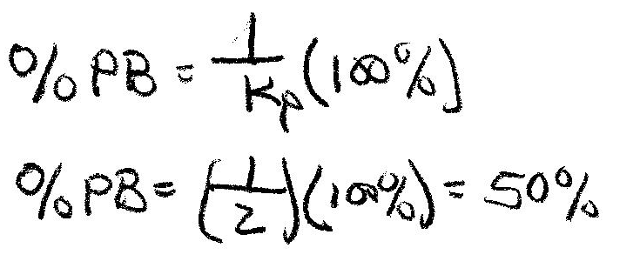
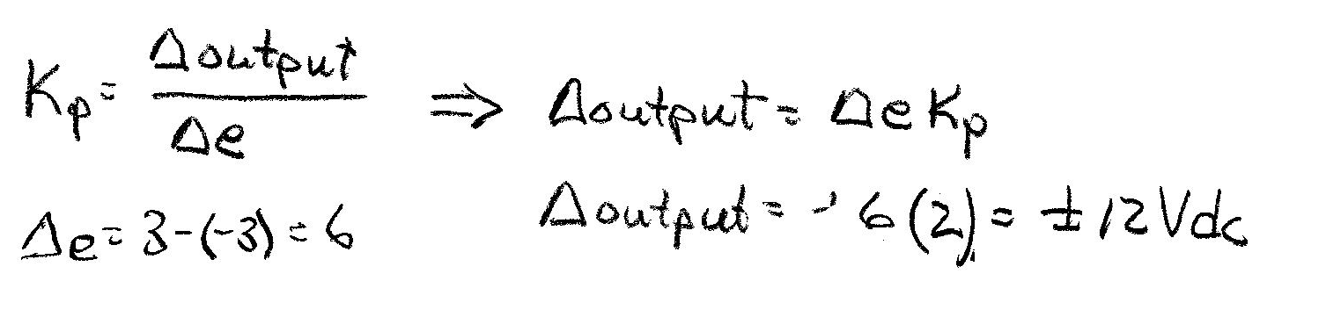
Example 9-1 Solution
Now set the value of proportional gain to 2 and compute the %PB and output
Lower gain allows the OP AMP to handle more error before saturation.

Slide 12
Characteristics of Proportional Control
Control formula
V_{o} = K_{p}∙e + V_{b}
V_{o}
+15V
K_{p}(e)
Bias, V_{b}
V_{b}
If e = 0, then V_{o} = V_{b}
K_{p}
0 V
e
If e≠0, then every unit of error produces K_{p}(e) units of correction that is added/subtracted to V_{o}.
0
0.1
There is a band of steady-state error about 0 with magnitude of PB% where the output is not
saturated.

Slide 13
Control Offset and Residual Error
Proportional control always produces a steady-state or residual error when a change in the process load occurs. (When e≠0)
V_{o}
+15V
Increasing K_{p} decreases steady-state error be can not eliminate it.
Load
Change
e=0
V_{b}
K_{p}
0 V
e
Permanent load changes produce permanent error. For transient load changes, the error returns to bias value, 0.
Residual
Error

Slide 14
Increased Gain & Residual Error
High gain reduces steady-state error but increases chances of instability
Example 9-2: A proportional controller with a gain of 2 has an output range of 0-15 Vdc for an error input range of 0 to ±1 Vdc. The output has a balance value of 7.5 Vdc. Determine: a.) controller output when error is zero, b.) residual error when a process load change produces and an error voltage of -0.25 Vdc, c.) residual error when control gain increases to 5.

Slide 15
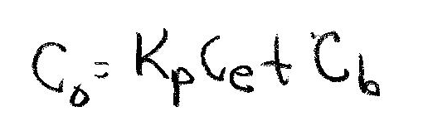
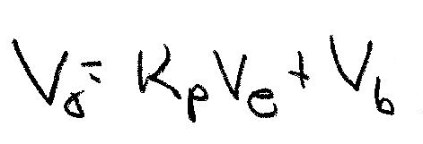
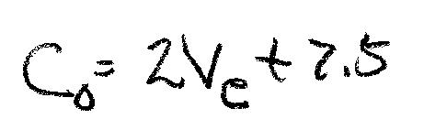
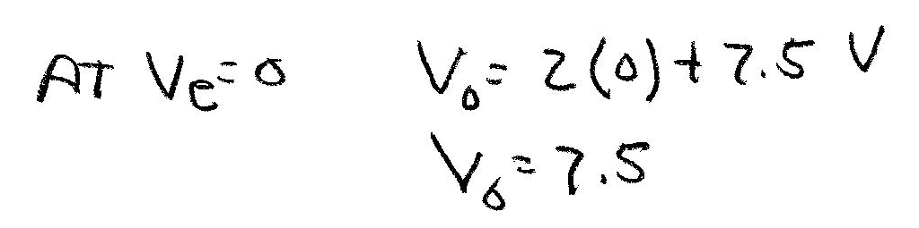
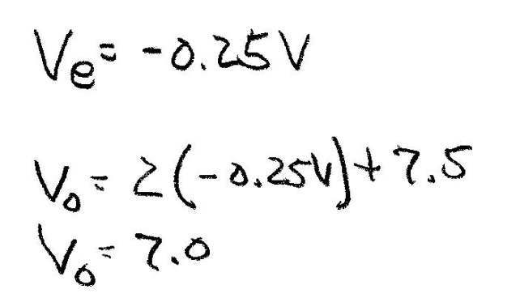
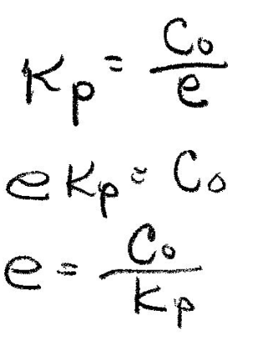
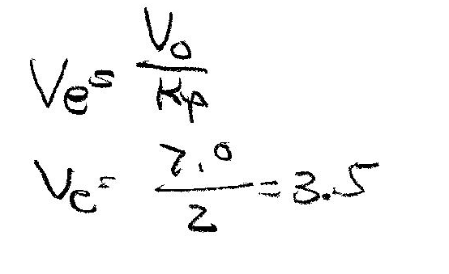
Example 9-2 Solution (1)
For K_{p}=2, V_{o}=C_{o}=0-15 Vdc, and V_{e}=e= 0 to ±1 Vdc. Also V_{b}=C_{b}=7.5 Vdc.
No residual error
(Steady-state error)
Ans
Process load change produces…
Find residual error….
Ans

Slide 16
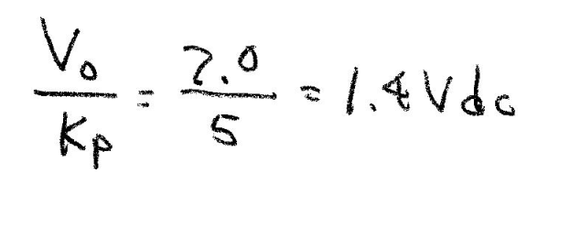
Example 9-2 Solution (2)
For residual (stead-state) error to reach 0, K_{p} must increase to infinity. Set K_{p}=5 and compute new residual error
Residual or steady-state error decreases inversely as the proportional gain increases

Slide 17
Error As a Function of Proportional Gain
Computing residual error
Where: SS_{d} = desired steady-state output (1 for
unit step)
SS_{a} = actual output at steady-state
%_error= percentage of residual error based on desired value.
Plot the change in residual error as the proportional gain increases using a typical control system

Slide 18
Error As a Function of Proportional Gain
Low values of
K_{p} produce high residual
error

Slide 19
Model of Proportional System (Bias = 0)
Block Diagram
C_{b} =0
x(t)
+
Plant
τ = RC
+
e(t)
K_{p}
-
+
r(t)
Setpoint
K_{d}
Controller
x(t) = input function
K_{p} = Proportional controller gain
Plant is modeled using RC circuit
r(t) = output response of the control system
K_{d} = feedback gain (voltage divider in lab)

Slide 20
Proportional System Time Response
Method of solution: Signal flow algebra and Laplace transforms
Final solution to step change input:
K_{p} affects
response speed
K_{p} affects final value
Plot the response of this system to a step input (0-1) for several values of proportional gain and compare them based on response speed and residual error.

Slide 21
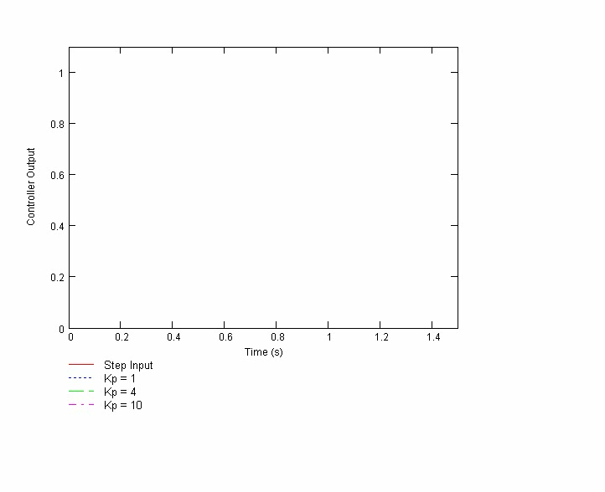
Proportional System Time Response
Comparison of response time and residual errors

Slide 22
End Lesson 9: Proportional Control Action
ET 438a Automatic Control Systems Technology

